Slide 1
Intro to Computer Science
MIT WTP 2022

Slide 2
Programming for the course (pun intended)
Daily class time
2:45 – 5:15 PM ET
Lecture – break – lecture – break – exercises/homework
Zoom
Office hours
8:30 – 9:30 PM ET
Zoom, Slack/Discord

Slide 3
What is computer science?
Using computers as a tool to solve other problems
Finding optimal solutions to problems
Thinking about what kinds of problems are hard for computers and why
Figuring out ways to improve people’s lives using computers
“Computer science is no more about computers than astronomy is about telescopes” – E.W. Dijkstra
Notes:
Ok thank you university of Maryland but what in the world does that entail?

Slide 4
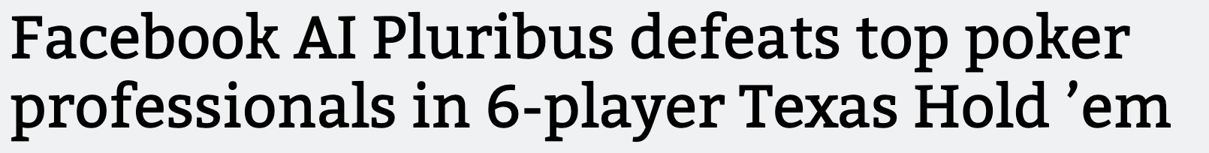




What can you do with computer science?

Slide 5
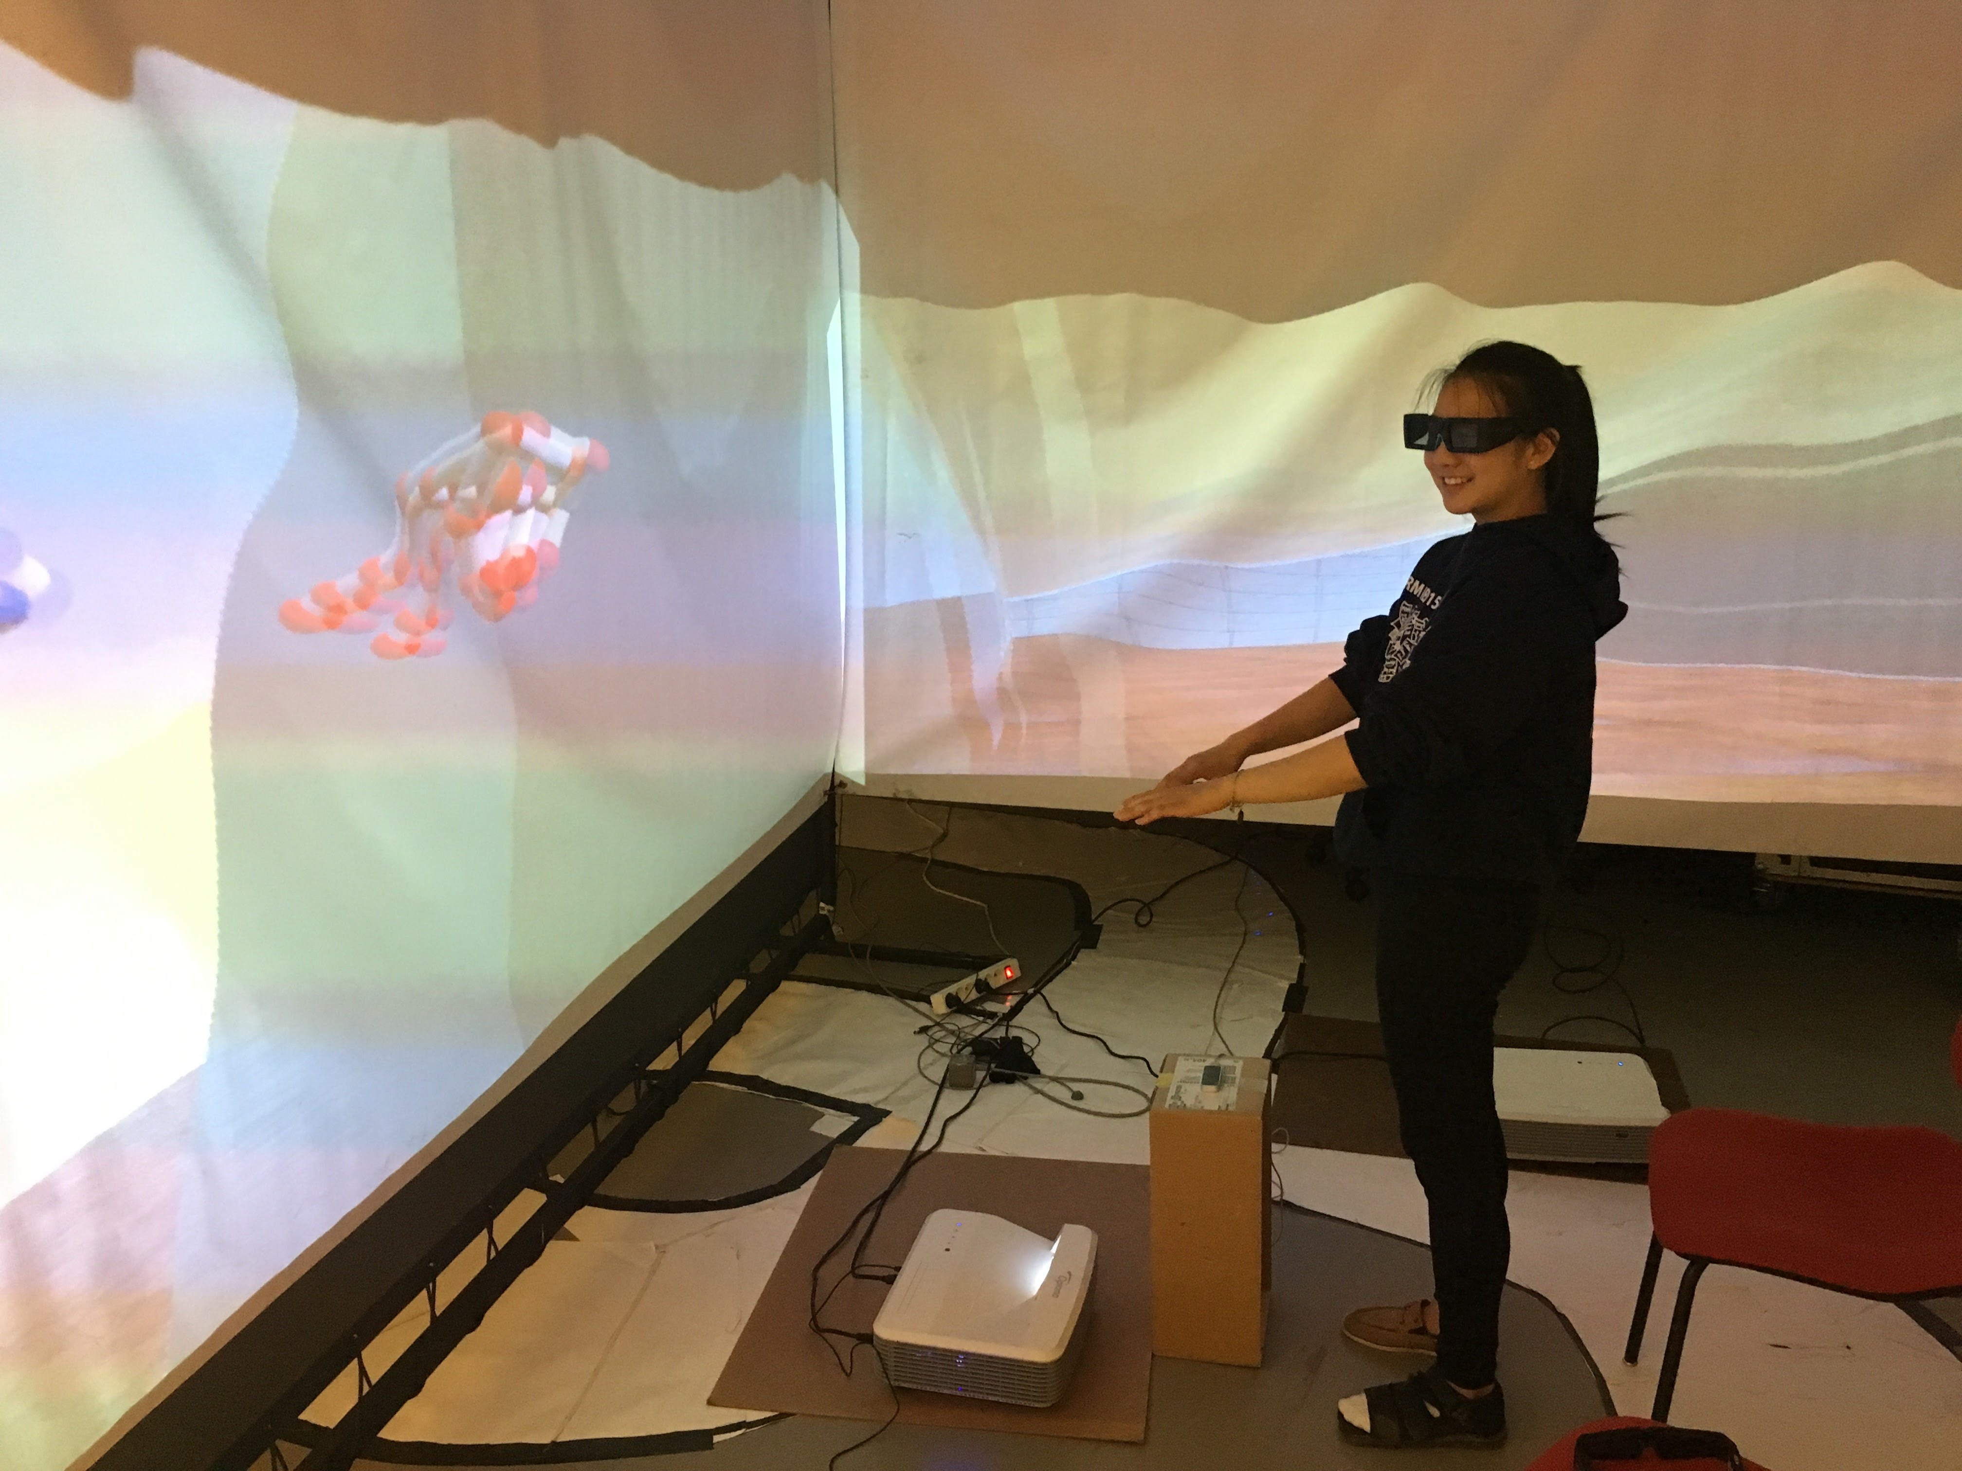
What have I worked on?
SUMMER 2016
ESIEE Paris
Built a 3D virtual tour of the building I worked in!

Slide 6
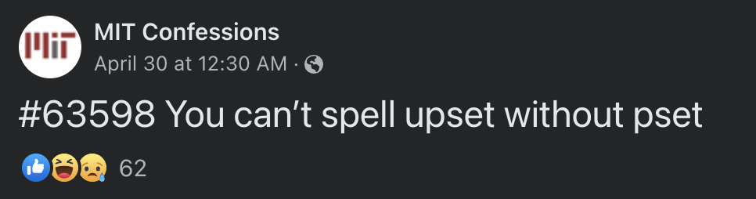
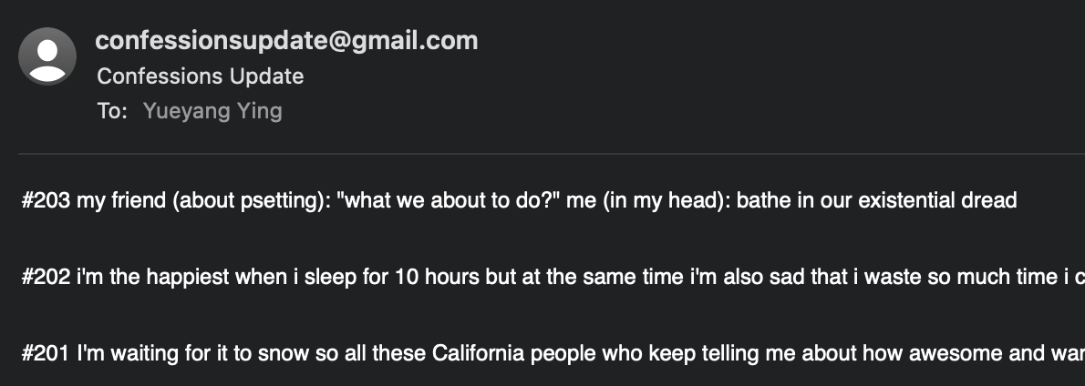
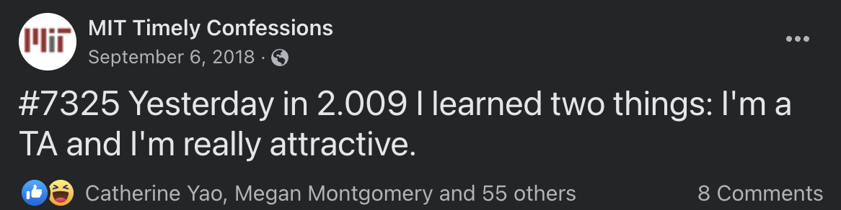
What have I worked on?
FALL 2016
MIT Confessions Scraper

Slide 7
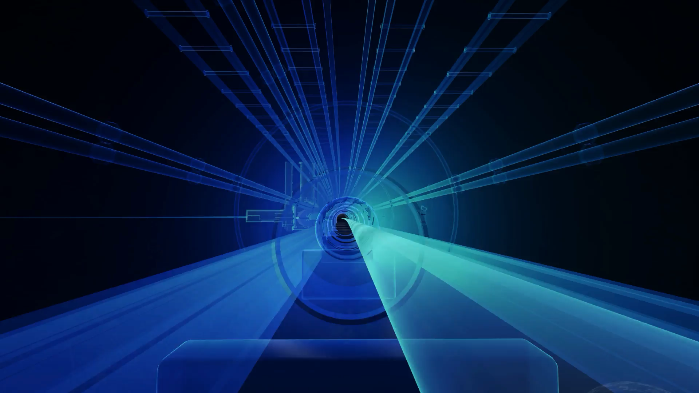
What have I worked on?
2020-2022
MIT/CERN

Slide 8
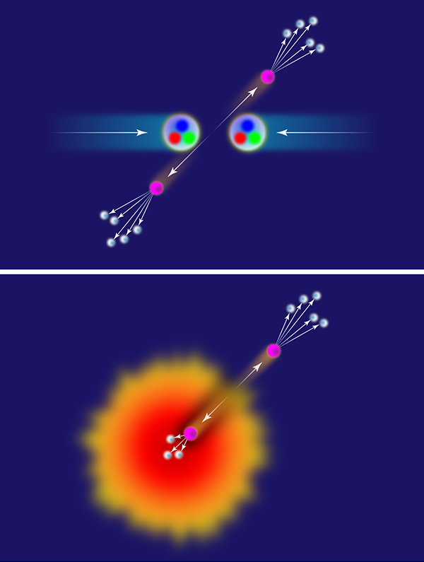
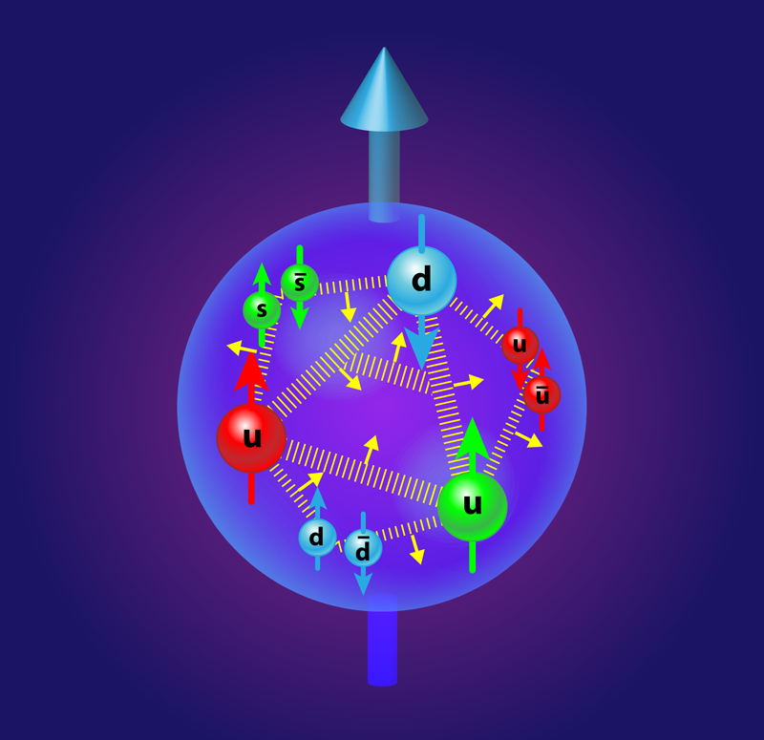
What have I worked on?
2020-2022
MIT/CERN
Collision “kicks out” particle from the nuclei, which produces a jet
Quarks
Gluons
Lead-lead collisions produce the quark gluon plasma (QGP)

Slide 9
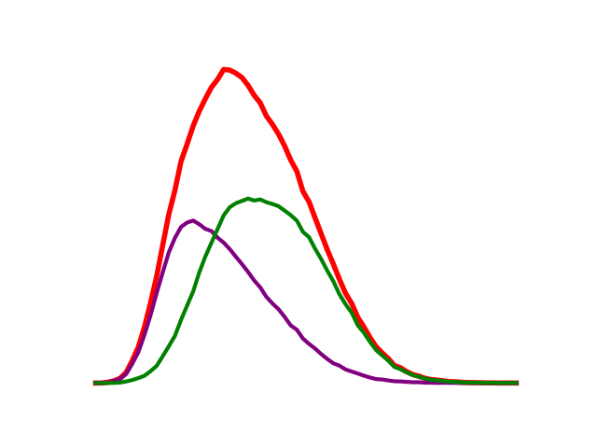
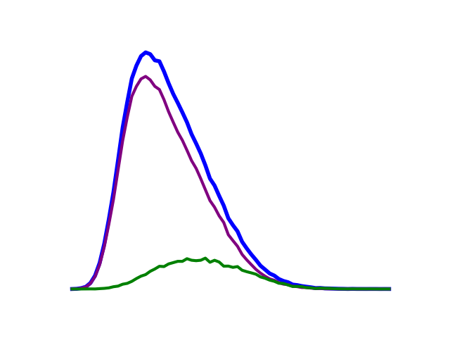
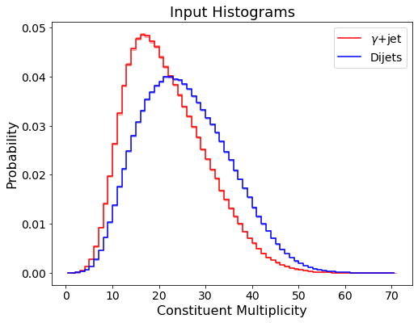
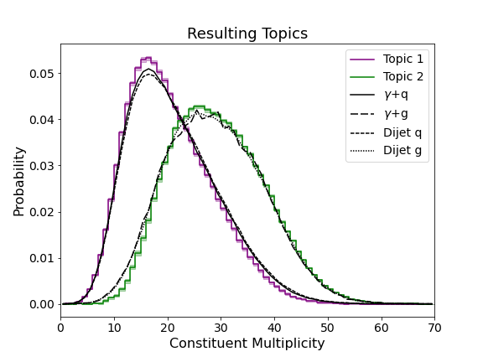
What have I worked on?
2020-2022
MIT/CERN
Quarks
Gluons
Machine
Learning!

Slide 10
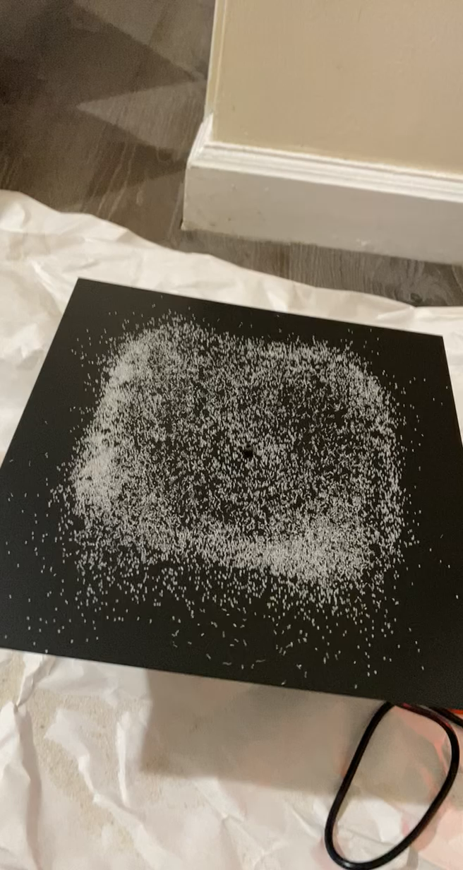
What have I worked on?
2021-2022
Arabesques
NFT art project with inspiration from physics

Slide 11
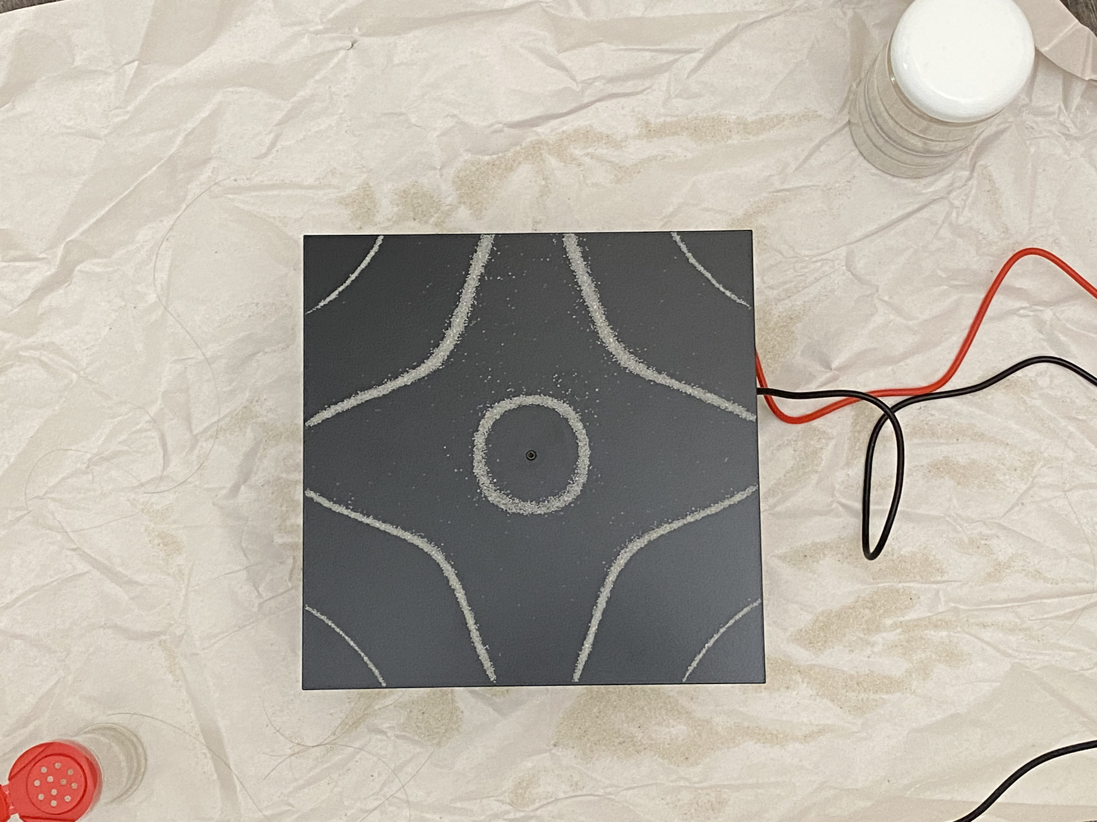
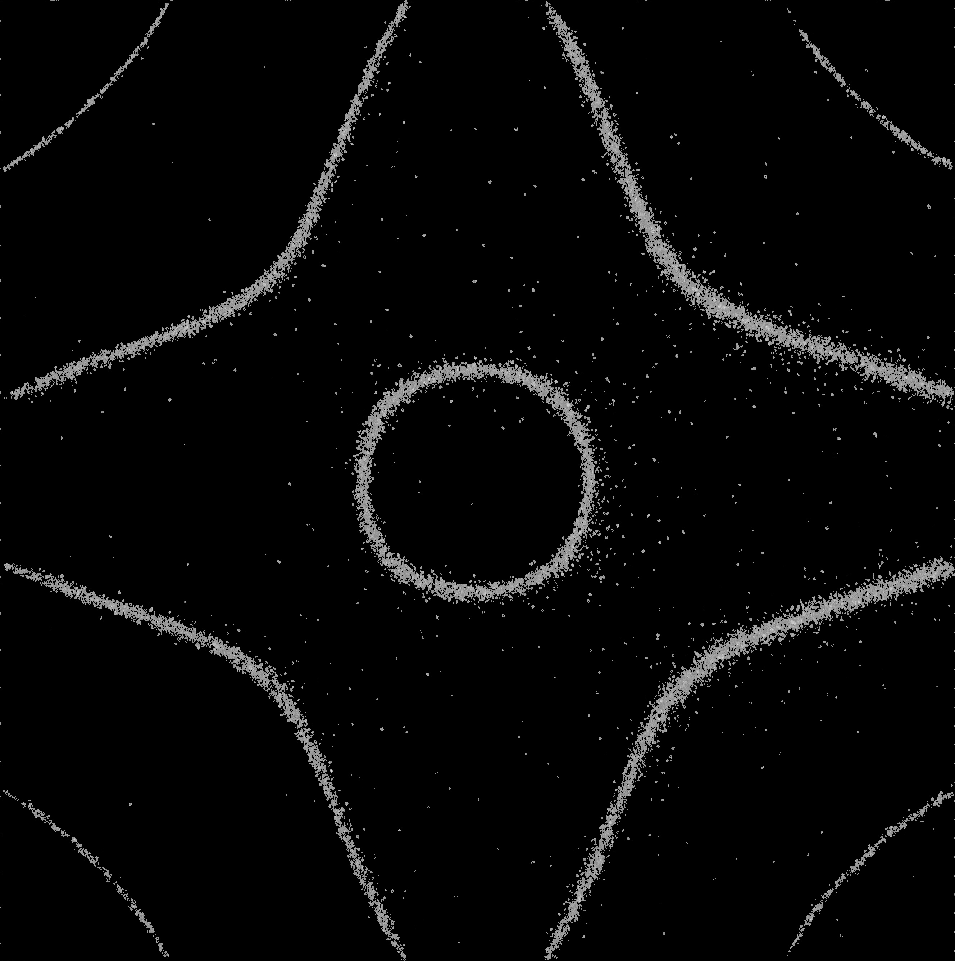
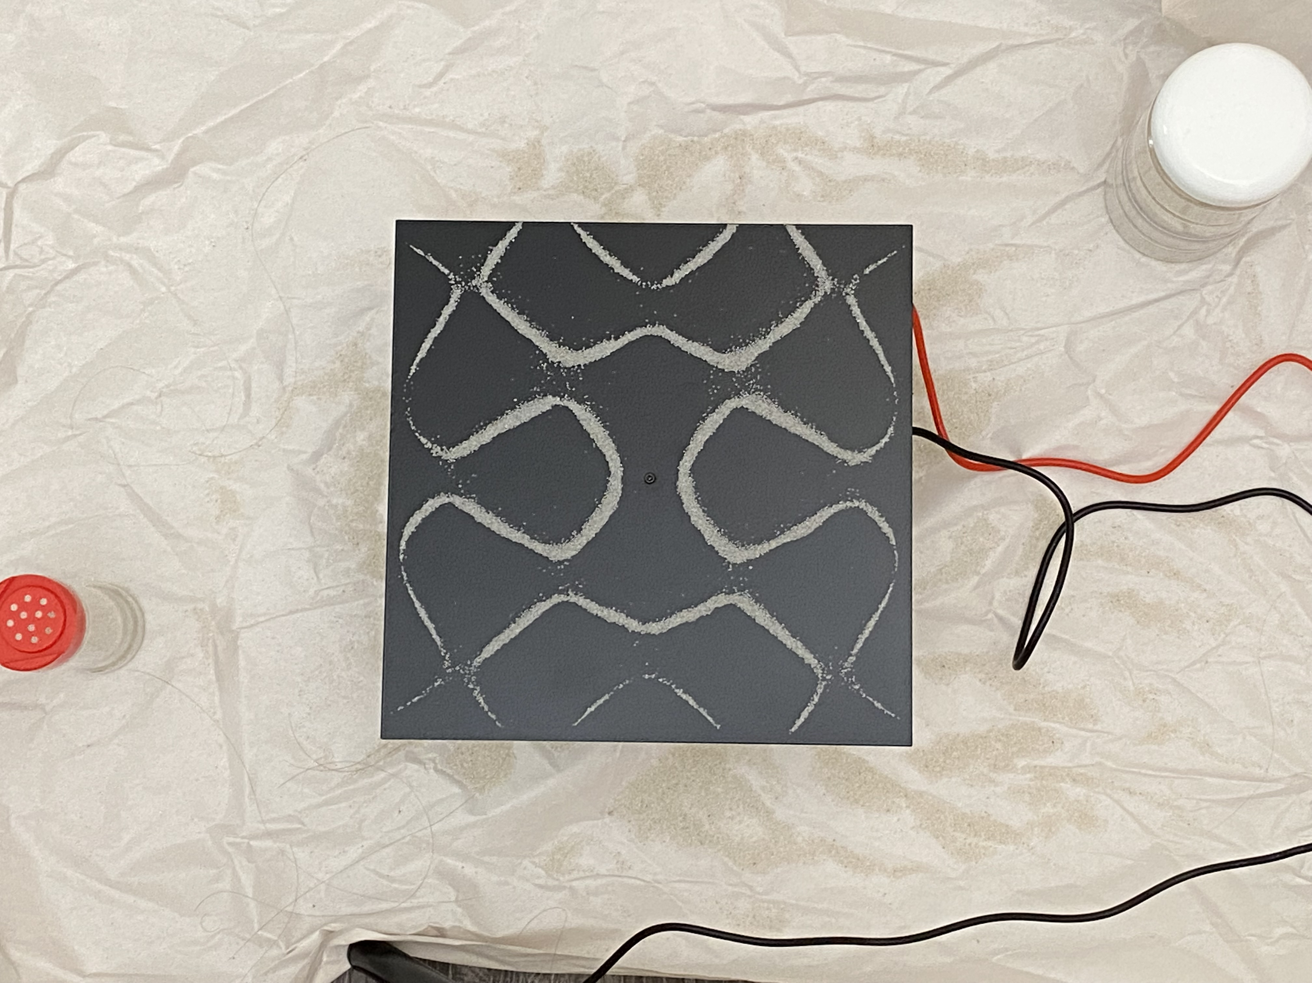

What have I worked on?
2021-2022
Arabesques
NFT art project with inspiration from physics

Slide 12
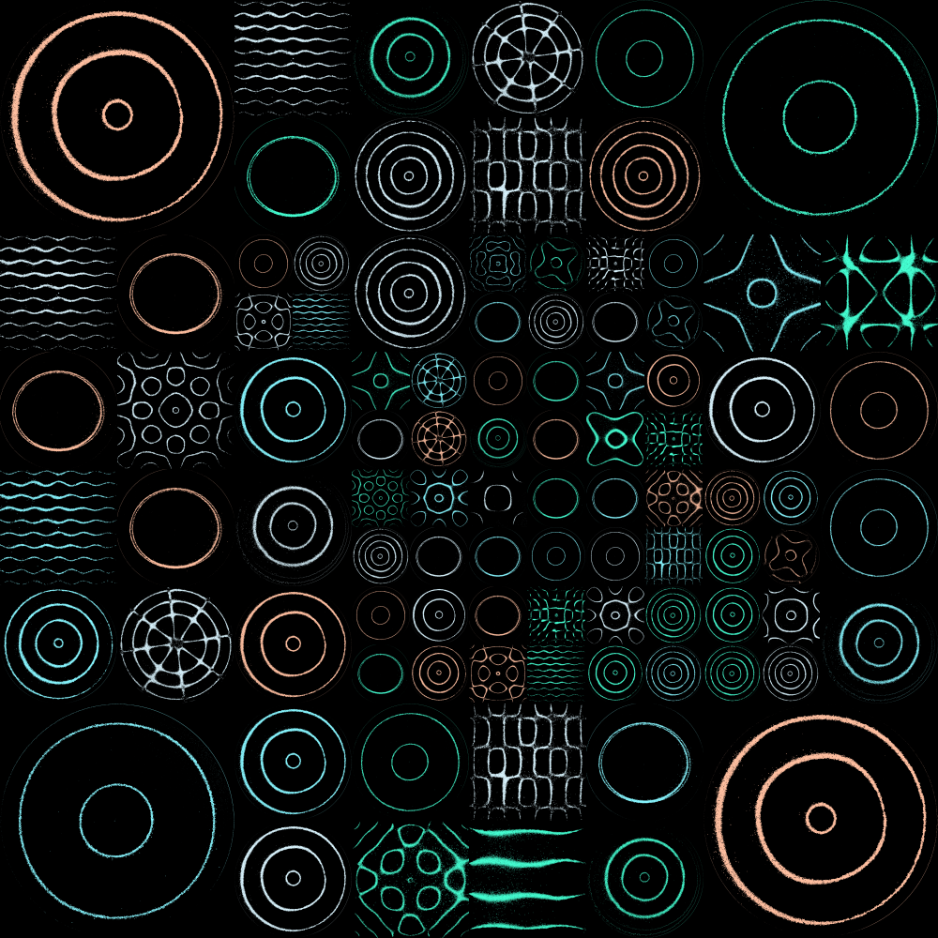
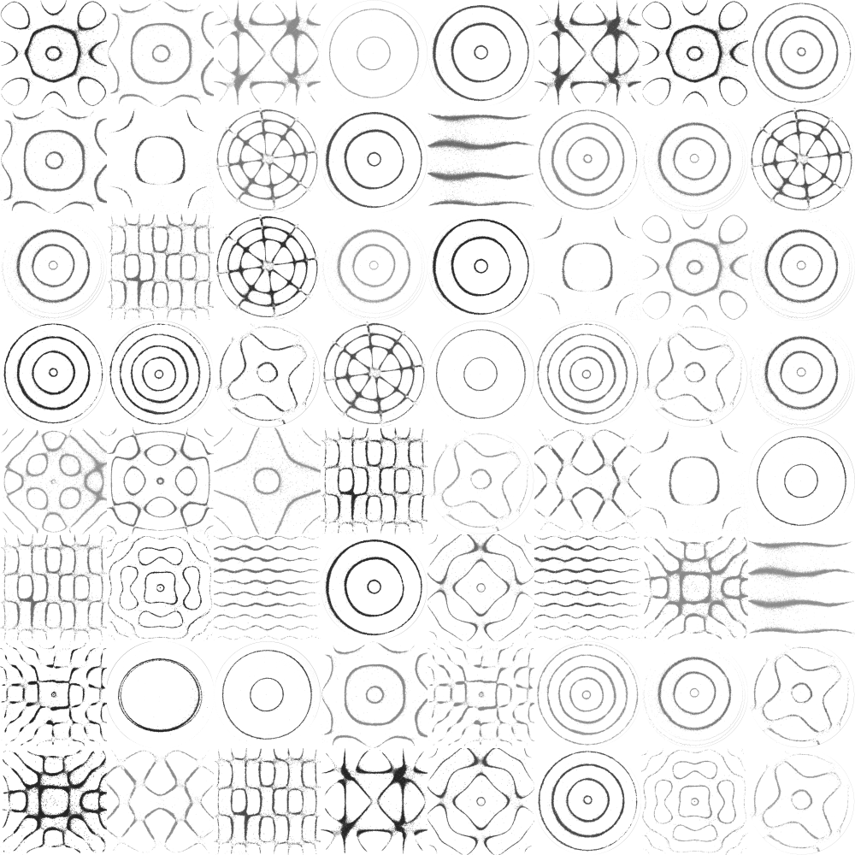
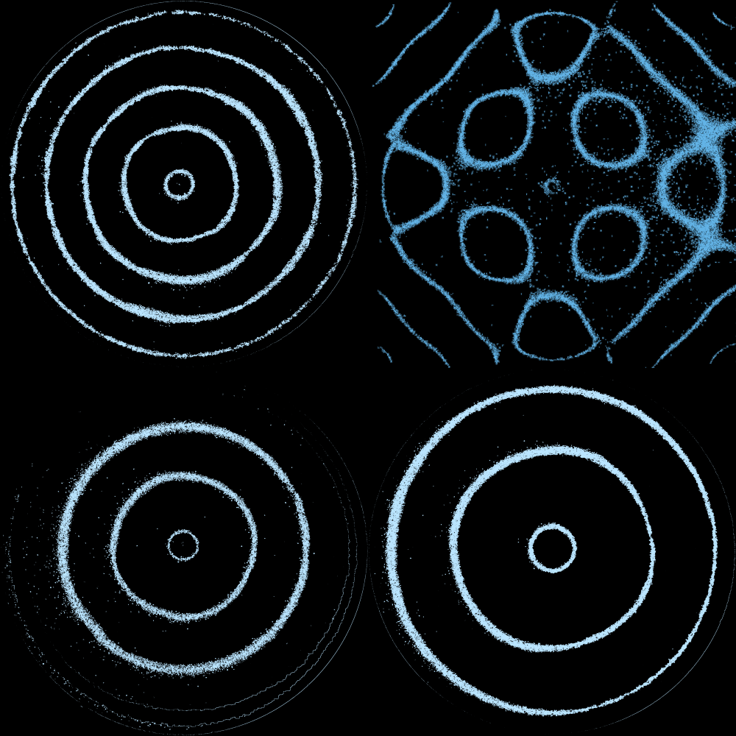



What have I worked on?
2021-2022
Arabesques
NFT art project with inspiration from physics

Slide 13
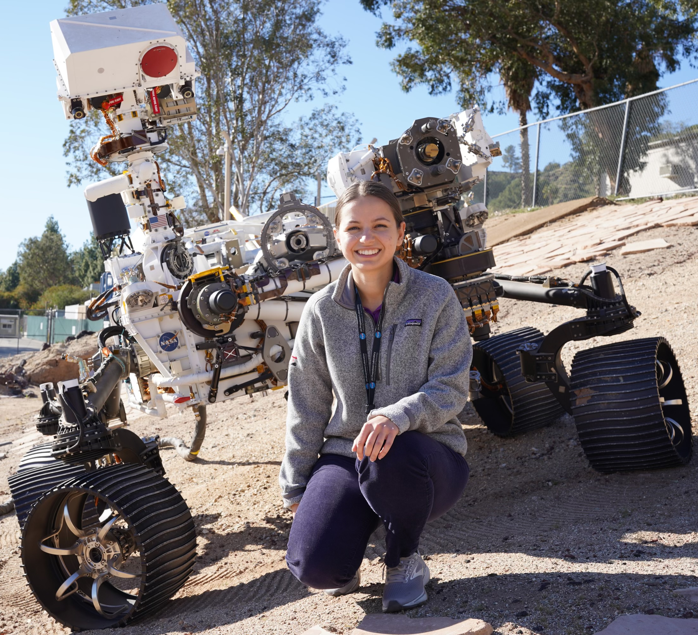

What about my friends?
Nadya Balabanska
NASA JPL
Anna Bair
CMU PHD Student
Notes:
Nads – drives the rover. Rover planner, write code that gets executed by the rover everyday to do the drive and arm activities. Work on development for ground command tools
Anna - research on deep learning and understanding how neural nets work

Slide 14
Ok enough about me…
Let’s talk programming

Slide 15

What is the goal of this course?
To learn to program
Uses thinking skills from math, engineering, and science!
To learn to problem solve
We will be learning how to program using Python!
Notes:
Ask if anyone has any ideas
Math – formal languages to denote ideas
Engineers – design things using systems, evaluating tradeoffs
Scientists – observe behaviors, dev hypotheses, test predictions

Slide 16



Who knows another language?

Slide 17
Who thinks they could write a book in that language?
Notes:
Maybe you don’t know the language well enough
Maybe you don’t have ideas for a book to write!
Programming is the same idea ☺ Often, it’s the ideas behind the programs that count! Languages are interchangeable as long as you can figure out the syntax.
Note-taking: it’s fine, but just like languages, you learn more by doing! If you think note taking helps, go ahead, but I will have lecture notes and online materials available for you ☺ Personally, I believe that with coding, practice and repetition are the most useful. So, I would just pay attention!

Slide 18
The core of programming
Program (or script) – sequence of instructions that specifies how to perform a computation
Basic instructions:
Input – getting data from keyboard, file, network, etc.
Output – display data on the screen, save it somewhere, send it somewhere, etc.
Math – basic math like addition, multiplication
Conditional execution – checking for conditions and following the appropriate path
Repetition – perform some action repeatedly

Slide 19

The core of programming
Program (or script) – sequence of instructions that specifies how to perform a computation
Basic instructions:
Input – getting data from keyboard, file, network, etc.
Output – display data on the screen, save it somewhere, send it somewhere, etc.
Math – basic math like addition, multiplication
Conditional execution – checking for conditions and following the appropriate path
Repetition – perform some action repeatedly

